Slide 1
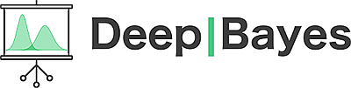
Variational Dropout
Sparsifies
Deep Neural Networks
Dmitry Molchanov* Arsenii Ashukha* Dmitry Vetrov
August 30th 2017

Slide 2
Outline
Gaussian Dropout
Variational Dropout
Sparse Variational Dropout
Technical details
Experiments

Slide 3
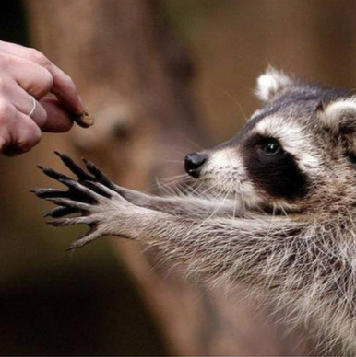

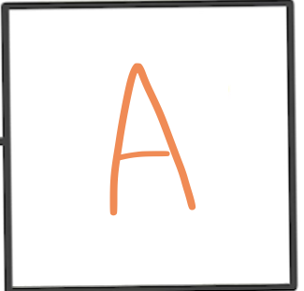
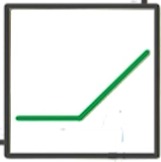
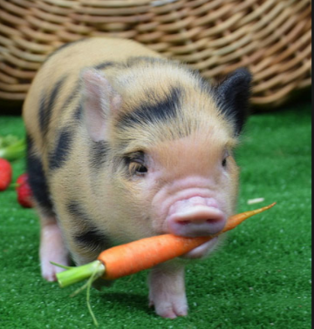
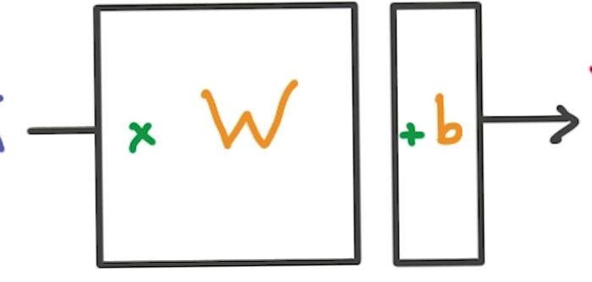

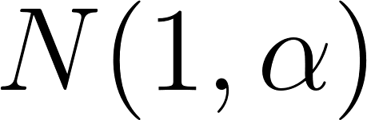
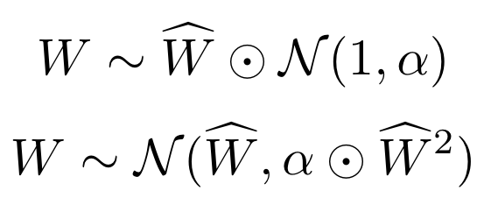
Gaussian Dropout
weights
input
noise
activations
nonlinearity
It does not change the mean value
adds multiplicative noise

Slide 4
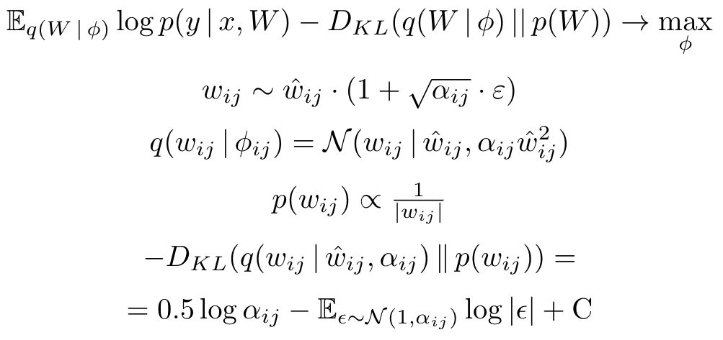
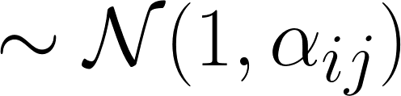
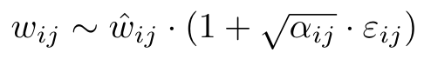
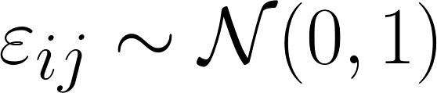
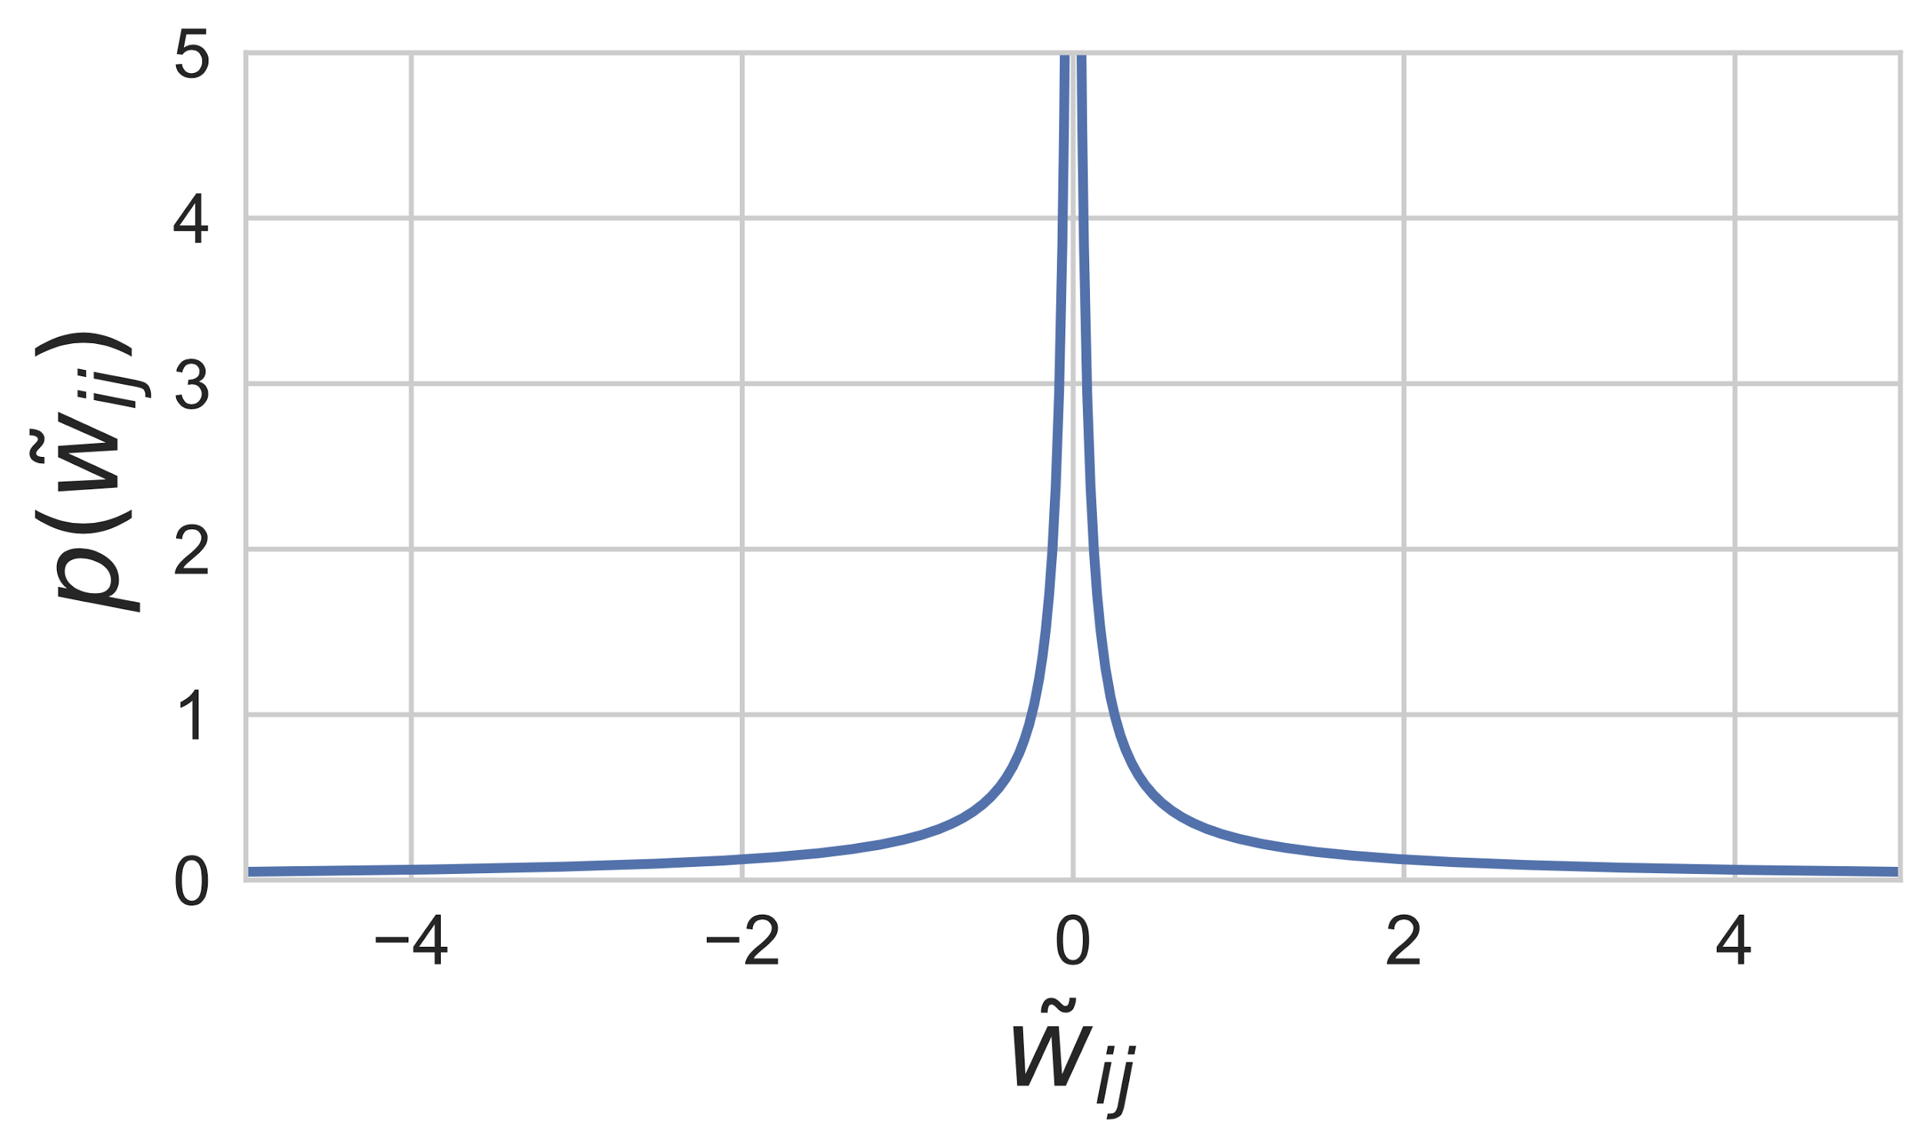
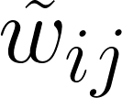
Variational Dropout
Gaussian Dropout with noise
Posterior distribution
Prior distribution and the KL divergence term
Does not depend on
Diederik Kingma, Tim Salimans, and Max Welling, Variational dropout and the local reparameterization trick
Notes:
\mathbb{E}_{q(\widetilde{W}\,|\,\phi)}\log p(y\,|\,x, \widetilde{W}) - D_{KL}(q(\widetilde{W}\,|\,\phi)\,||\,p(\widetilde{W})) \to \max_\phi
\tilde{w_{ij}} \sim w_{ij} \cdot (1 + \sqrt{\alpha_{ij}} \cdot \varepsilon)
q(\tilde{w}_{ij} \,|\, \phi_{ij}) = \mathcal{N}(\tilde{w}_{ij}\,|\, w_{ij}, \alpha_{ij} w_{ij}^2)
p(\tilde{w}_{ij}) \propto \tfrac{1}{|\tilde{w}_{ij}|}
-D_{KL}(q(\tilde{w}_{ij} \,|\,\w_{ij}, \alpha_{ij})\,\|\,p(w_{ij}))=\\
0.5\log\alpha_{ij}-\mathbb{E}_{\epsilon\sim\mathcal{N}(1, \alpha_{ij})}\log|\epsilon|+\mathrm{C}

Slide 5
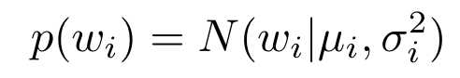
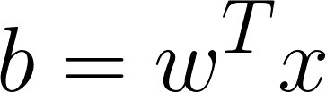
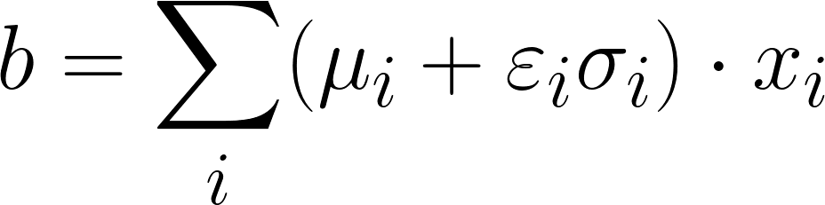
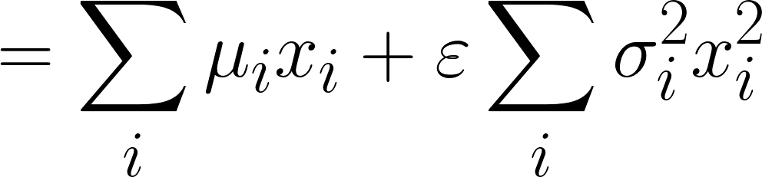
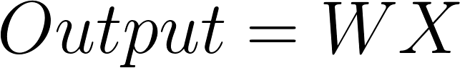
Variational Dropout with the LRT
Local Reparameterization:
Variational Dropout + Local Reparameterization
Notes:
N(\widetilde{w}_i) = N(\mu_i, \sigma_i)
b = \sum_{i} (\mu_i + \varepsilon_i \sigma_i) \cdot x_i =
= \sum_{i} \mu_i x_i + \varepsilon \sum_{i} \sigma_i^2 x_i^2

Slide 6
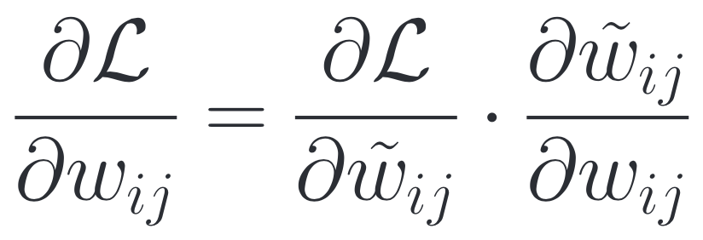
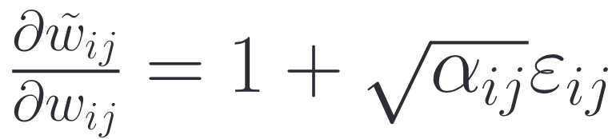
Variance Reduction
The variance of the gradients goes out of control when 𝛼 are large
Very noisy!
Solution: restrict 0 < 𝛼 < 1 (Kingma, et. al.)
It prohibits to use large alphas!
Notes:
\frac{\partial\mathcal{L}}{\partial w_{ij}}=\frac{\partial\mathcal{L}}{\partial \tilde{w}_{ij}}\cdot\frac{\partial \tilde{w}_{ij}}{\partial w_{ij}}
\tilde{w}_{ij}=w_{ij}(1+\sqrt{\alpha_{ij}}\varepsilon_{ij})
\frac{\partial \tilde{w}_{ij}}{\partial w_{ij}}=1+\sqrt{\alpha_{ij}}\varepsilon_{ij}
\frac{\partial \tilde{w}_{ij}}{\partial w_{ij}}=1
\tilde{w}_{ij}=w_{ij}+\sqrt{\alpha_{ij}w_{ij}^2}\cdot\varepsilon_{ij}=w_{ij}+\sigma_{ij}\varepsilon_{ij}

Slide 7
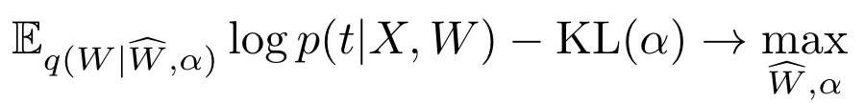
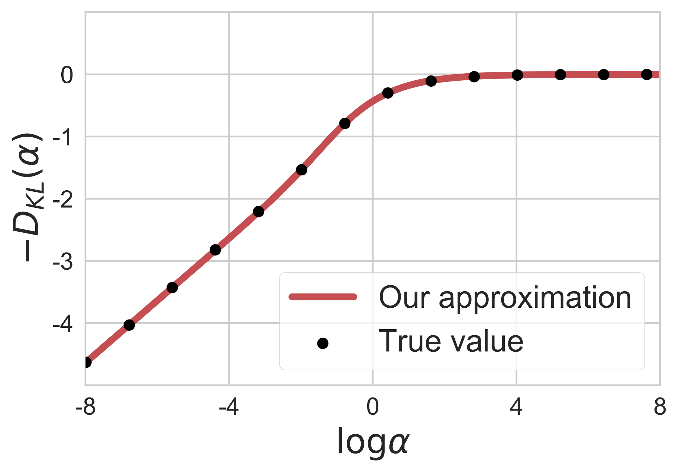
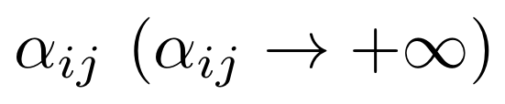
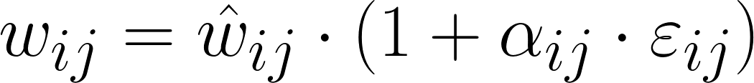
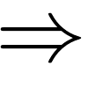
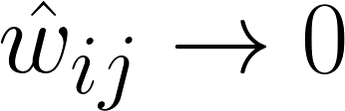
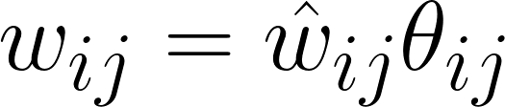
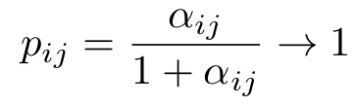
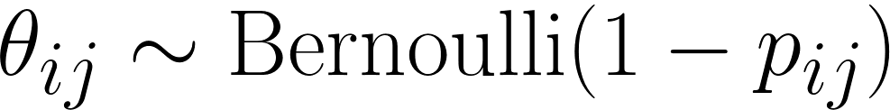
Why do we need large alphas?
The KL term favors large dropout rates α
Large means:
Infinitely large noise that corrupts the data term
Equivalent binary dropout rate goes to 1
Notes:
p_{ij}=\frac{\alpha_{ij}}{1+\alpha_{ij}}\to1
\alpha_{ij}\ (\alpha_{ij}\to+\infty)
w_{ij}\to0,\ \ \ \ \ q(w_{ij})\to\mathcal{N}(\hat{w}_{ij}\,|\,0, 0)

Slide 8
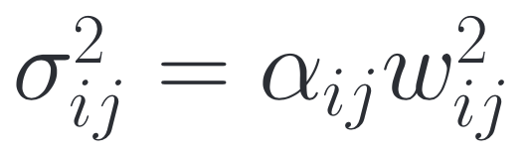
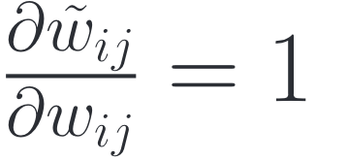
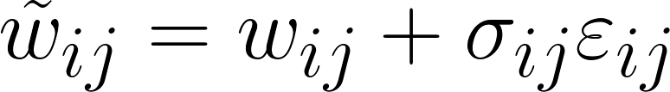
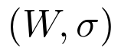
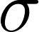
Variance Reduction
The variance of the gradients goes out of control when 𝛼 are large
Before:
Very noisy!
Solution: restrict 0 < 𝛼 < 1 (Kingma, et. al.) or …
… use Additive Noise Parameterization!
After:
No noise!
Optimize the VLB w.r.t.
is a new independent variable
Notes:
\frac{\partial\mathcal{L}}{\partial w_{ij}}=\frac{\partial\mathcal{L}}{\partial \tilde{w}_{ij}}\cdot\frac{\partial \tilde{w}_{ij}}{\partial w_{ij}}
\tilde{w}_{ij}=w_{ij}(1+\sqrt{\alpha_{ij}}\varepsilon_{ij})
\frac{\partial \tilde{w}_{ij}}{\partial w_{ij}}=1+\sqrt{\alpha_{ij}}\varepsilon_{ij}
\frac{\partial \tilde{w}_{ij}}{\partial w_{ij}}=1
\tilde{w}_{ij}=w_{ij}+\sigma_{ij}\varepsilon_{ij}

Slide 9
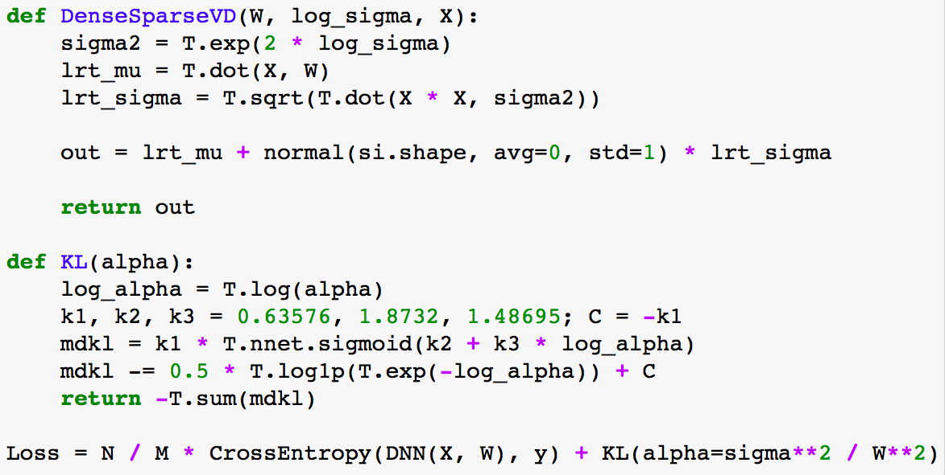
Sparse Variational Dropout: implementation
Notes:
def ForvardSparseLayer(W, log_sigma, X):
sigma2 = T.exp(2 * log_sigma)
lrt_mu = T.dot(X, W)
lrt_sigma = T.sqrt(T.dot(X * X, sigma2))
out = lrt_mu + normal(si.shape, avg=0, std=1) * lrt_sigma
return out
def KL(alpha):
log_alpha = T.log(alpha)
k1, k2, k3 = 0.63576, 1.8732, 1.48695; C = -k1
mdkl = k1 * T.nnet.sigmoid(k2 + k3 * log_alpha)
mdkl -= 0.5 * T.log1p(T.exp(-log_alpha)) + C
return -T.sum(mdkl)
Loss = CrossEntropy(DNN(X, W), y) + KL(alpha=sigma**2 / W**2)

Slide 10
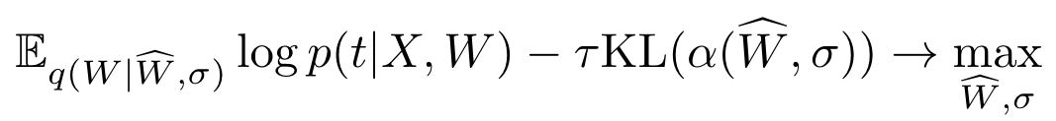
A problem: warm-up needed
Too many weights are pruned at the beginning
The KL term dominates the data-term early on
Use annealing of the KL coefficient!
Use 𝛕 = 0 for about 5 epochs
then linearly increase to 1 during ~10 epochs
and use 𝛕 = 1 after that

Slide 11
Other technical details
Use dropout rates for thresholding
We used log α = 3
No finetuning after thresholding is needed
One sigma per layer works just as well
And allows to speed-up computations
You can train simple models from scratch (with warm-up)
Pretrain large models with L2 and binary dropout
No warm-up needed in that case

Slide 12
… more technical details
Optimize w.r.t. log σ to avoid constrained optimization
Initialize σ with smaller values in convolutional layers
Convolutional layers are very sensitive to noise
Clip extreme values of α for numerical stability
We used -8 ≤ log α ≤ 8
Use Adam for optimization
To avoid manual tuning of separate learning rates for weights and variances

Slide 13
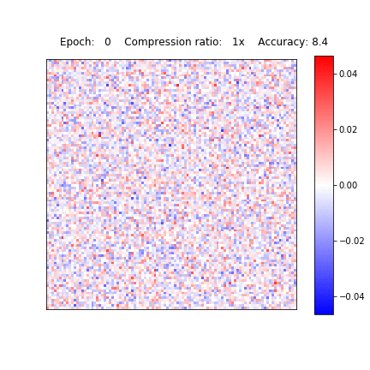
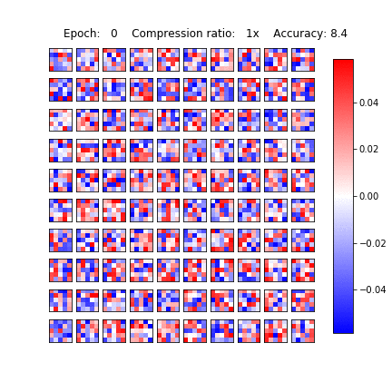
Visualization
LeNet-5: convolutional layer
LeNet-5: fully-connected layer
(100 x 100 patch)

Slide 14
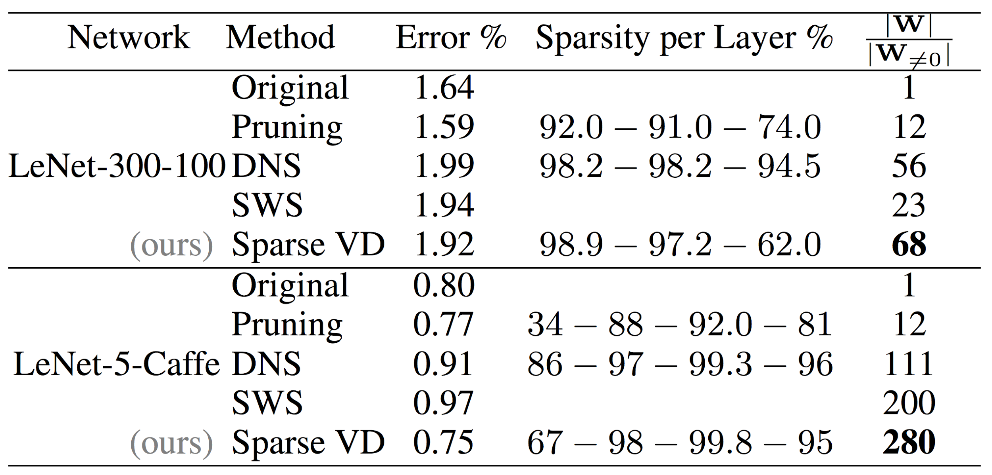
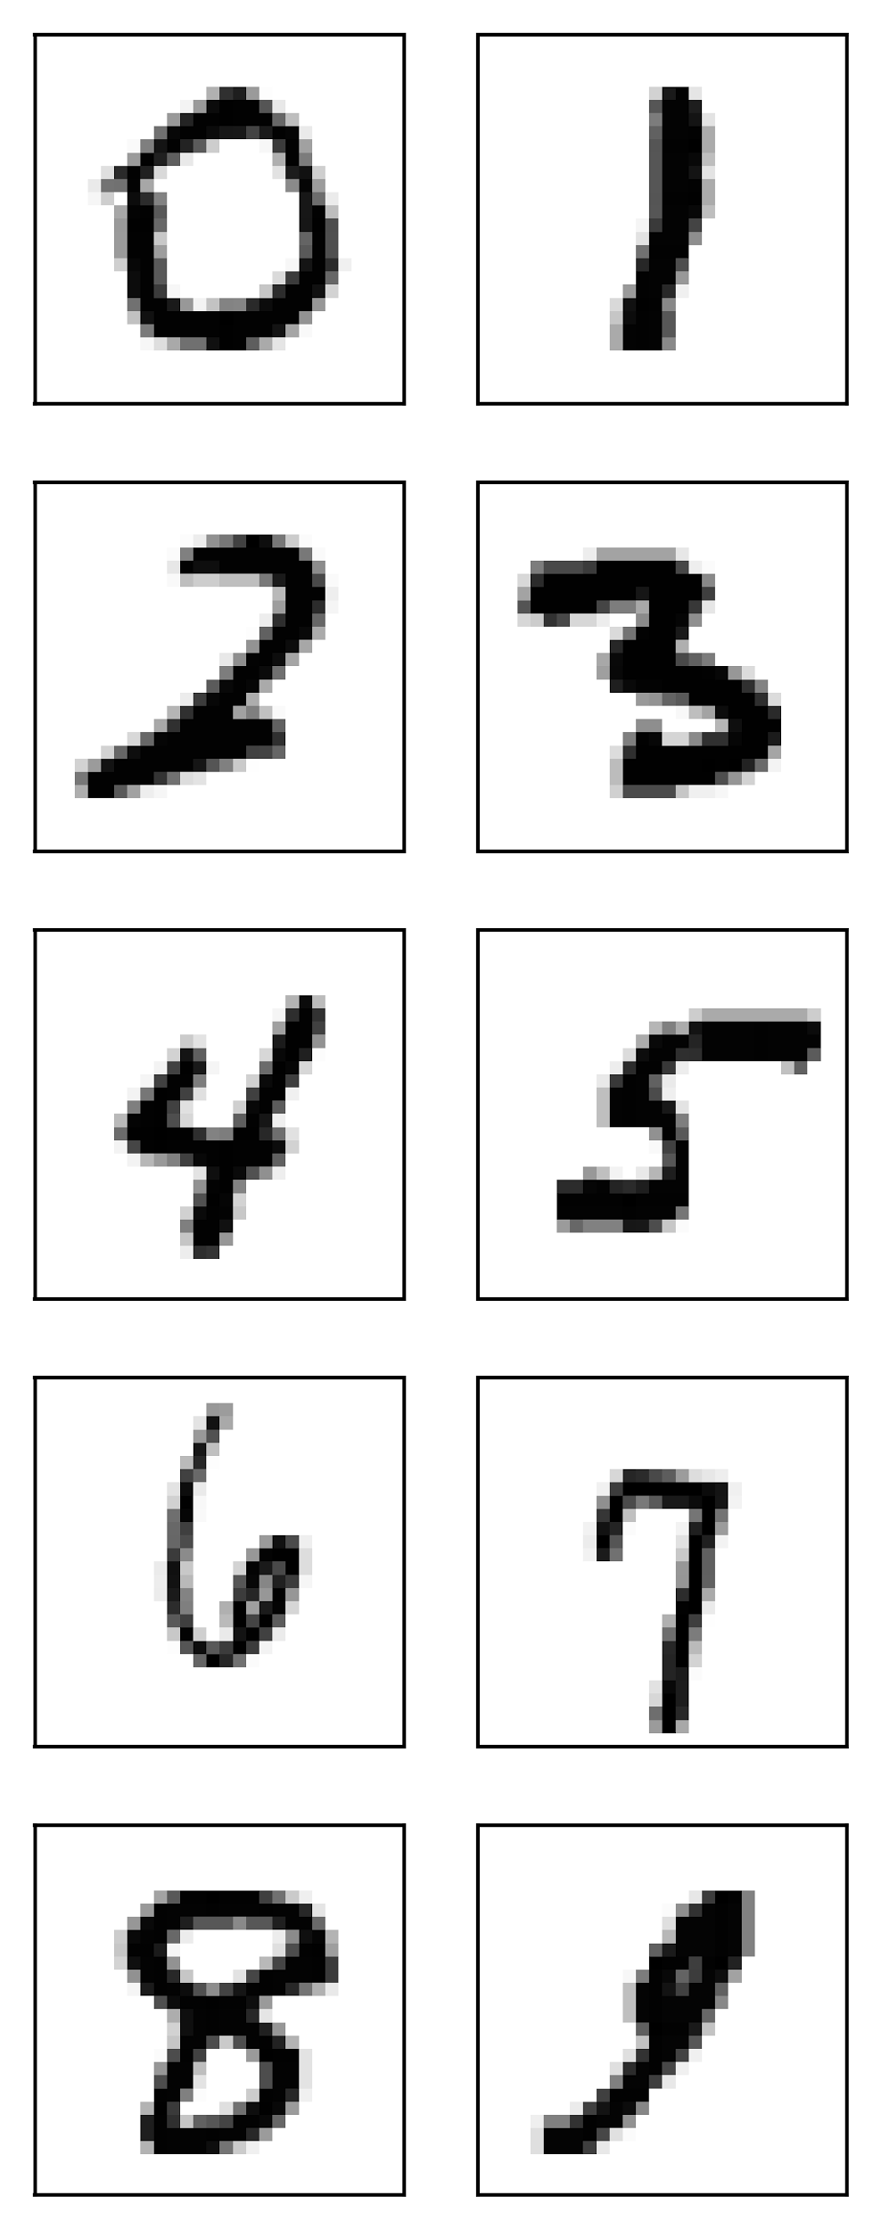
Lenet-5-Caffe and Lenet-300-100 on MNIST
Fully Connected network: LeNet-300-100 Convolutional network: Lenet-5-Caffe

Slide 15
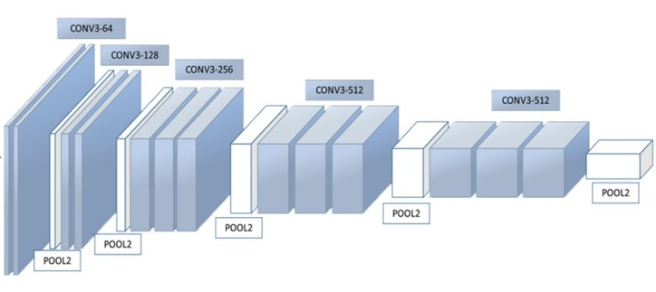
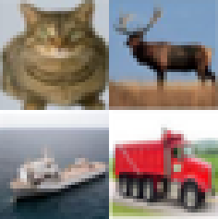
VGG-like on CIFAR-10
13 Convolutional layers and 2 Fully-Connected layers
Pre-Activation Batch Norm and Binary Dropout after each layer
Official Torch Blog: Zagoruyko, http://torch.ch/blog/2015/07/30/cifar.html

Slide 16
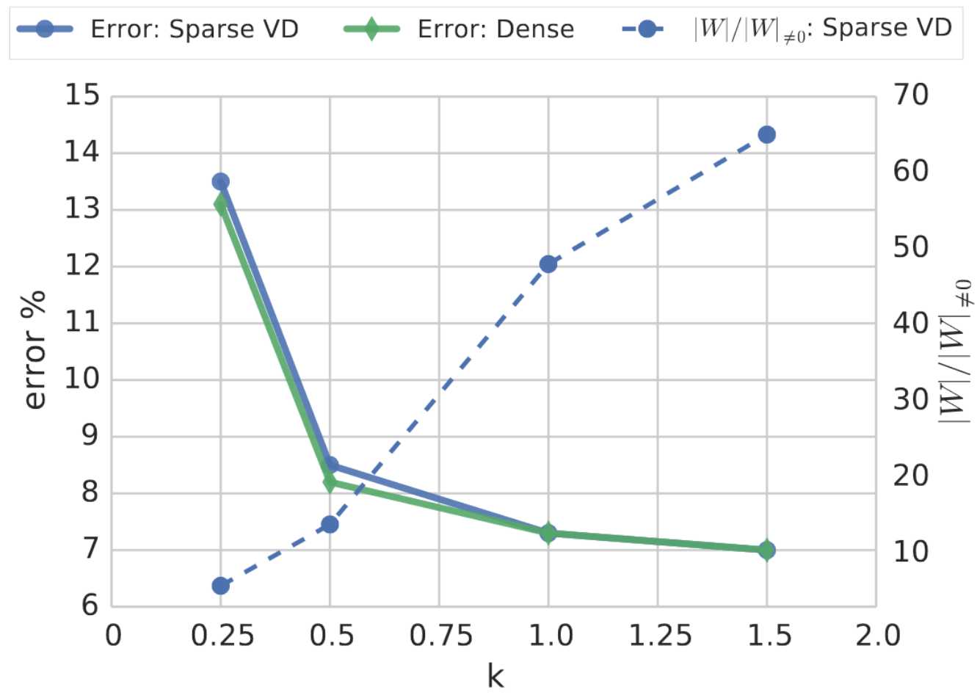
VGG-like on CIFAR-10
Number of filters / neurons is linearly scaled by k (the width of the network)
Error %
Compression rate
Model width scale factor k

Slide 17
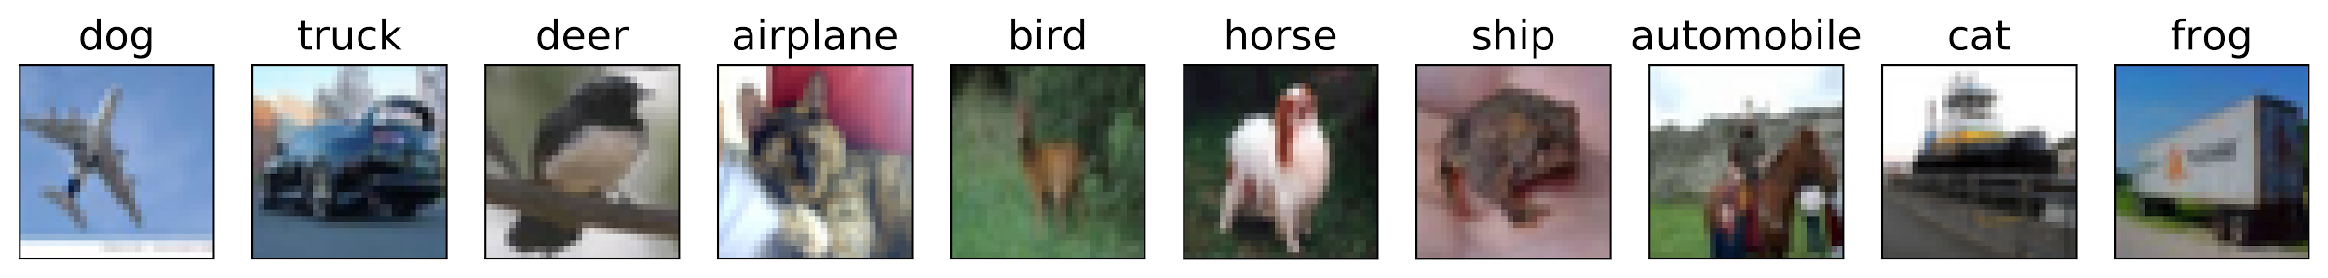
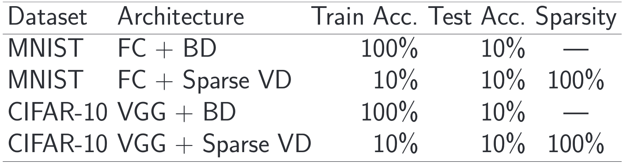
Random Labeling
No dependency between data and labels ⇒ Sparse VD yields an empty model where conventional models easily overfit.
Zhang, Chiyuan, et al. "Understanding deep learning requires rethinking generalization."

Slide 18
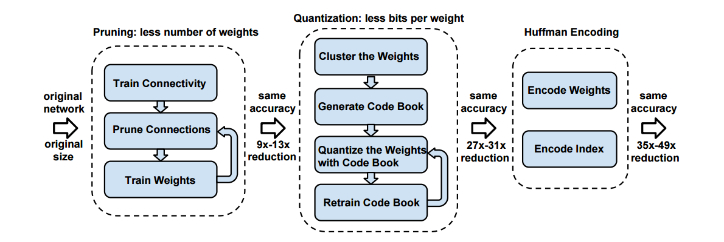
Future Extensions for Compression
Easy to incorporate into the Deep Compression framework: just replace pruning!
Sparse VD!
Soft Weight Sharing
In theory, it can also be combined with soft weight sharing that provides better quantization

Slide 19
Structured Bayesian Pruning via LogN Multiplicative Noise

Slide 20
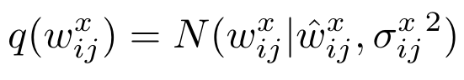
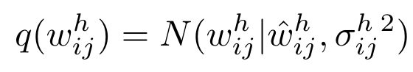
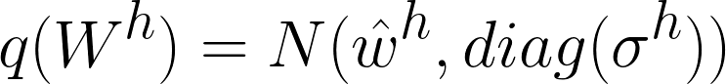

Bayesian Sparsification of Recurrent Neural Networks
Log-uniform prior
The same sample W for all timestamps
Plain RT for W
h

Slide 21

Bayesian Sparsification of RNNs: experiments

Slide 22

Bayesian Sparsification of RNNs: experiments

Slide 23


Sparse Variational Dropout
GitHub: https://goo.gl/2D4tFW
Additive Noise Parametrization reduces the variance of SG
Variational Dropout Sparsifies Deep Neural Networks
No hyperparameters, just the parameters of optimization
Follow-up papers:
Compression of RNNs: https://arxiv.org/abs/1708.00077
Group-wise sparsity: https://arxiv.org/abs/1705.07283

Slide 24
Group sparsity
Sparse VD provides general sparsity with no structure
Sparse VD can’t be efficiently generalized for group sparsity
Structured sparsity is the key to DNN acceleration
Structured sparsity allows more efficient compression

Slide 25

Noise sparsity
input
weights
noise
activations
nonlinearity
input
weights
activations
nonlinearity
noise

Slide 26
Distributions
Variational Dropout:
Log-Normal Dropout:

Slide 27

Results on MNIST

